Slide 1






You can’t protect what you can’t see.
However, Enterprises can be held accountable for the negligence of missing safeguards.
Enterprise Endpoint Safeguard Visibility

Slide 2

Pain points we are hearing in the market
Price: Cannot find a replacement product at the right price
Features: Promises made and not kept
Ie: Interactive enforcement
Implementation efforts and costs to replace are manual and office-by-office
Maintenance challenges
Devices
New, Unknown, BYOD, or non-compliant devices allowed to connect
Devices not online anymore, updates
Devices no longer in use or not associated with Firm (but still having software from the Firm)
Decommissioning not documented
User Data
Manual correlation of device, user, office, and supervisory data
Stale data
Change in security and compliance officers
Removing legacy and at-risk software

Slide 3
Visibility
You can’t protect what you can’t see
Next-Generation Endpoint Safeguard Audit
High-risk compliance dashboards
Surface things that need attention
EOL OS, Device no longer connected, Connecting from out of country, Not encrypted, No antivirus, Etc.
Enterprise and field office views
View by Location, Branch or Agency, Firm Code, Supervisory Code
Multiple grouping
Security officer portal
Features that create efficiency for Security Officers
High-Risk alerts
Efficient decommissioning
Update directory, device info, etc.
Automation

Slide 4
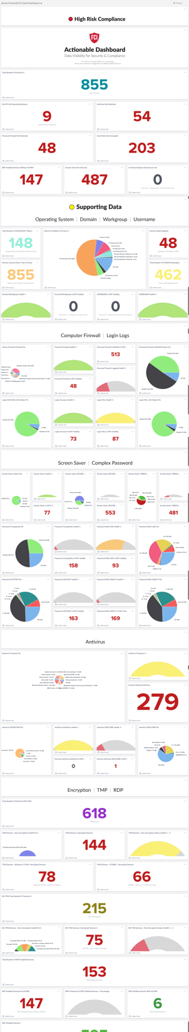
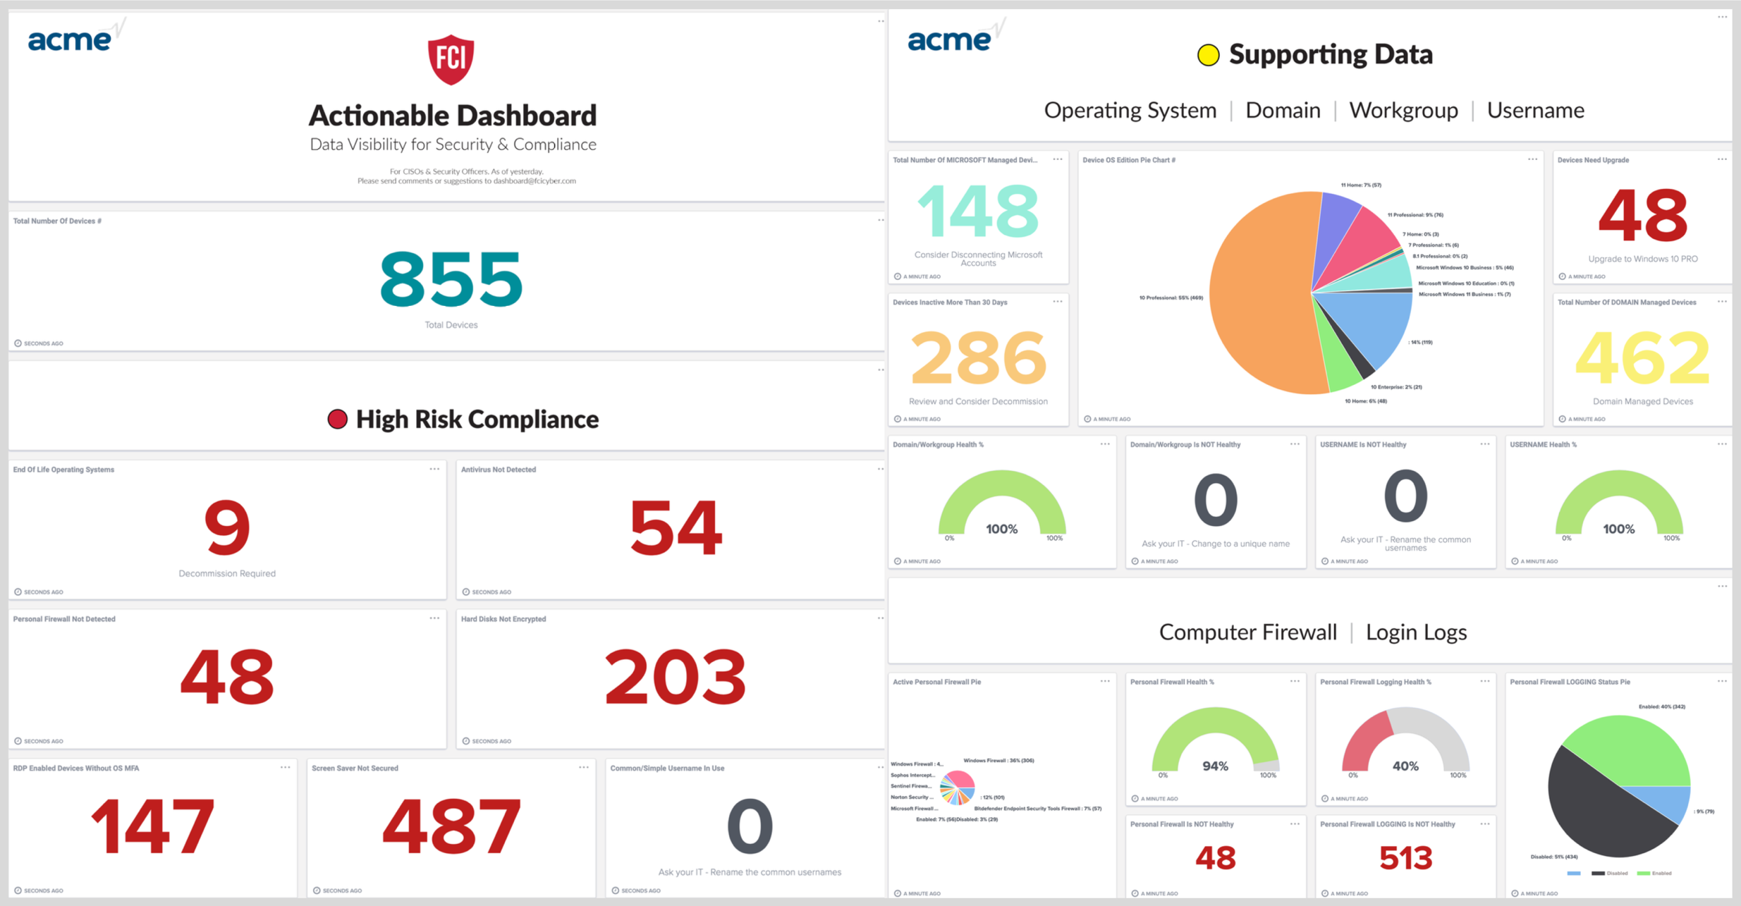
Actionable Dashboard
Notes:
It is to answer this question that we created the Actionable Dashboard
Switch to Acme Dashboard
You get here the actions that you or your firms have to take based on what is presented in the dashboard, which is directly an analysis, or a summary of the asset inventory report
The first section is presented the high-risk alerts
As an example, I see that 9 devices have an end-of-life operating system. If I click on the card, it shows them all, can download the list and act on it
There are close to 60 cards with supporting data from operating systems, domains, workgroup, usernames, and endpoints

Slide 5
Actionable Dashboard
View
Review dashboard gauges
List
Click on gauges to produce the list of devices
Act
Select devices and action to perform, ie:
Decommission device form
Duplicate Device serial number report for repurposed computers
List of computers with multiple AVs

Slide 6
Implementation
Project: 90% less resources, efforts, money, time than others
Installer options
Verbose one-click installer to distribute
Silent installer to integrate and automate
Automated legacy audit tool removal
CASB Integration to only allow known devices Examples of options when unknown devices try to connect:
Ask Security Officer for approval
Install FCI tool
Provide an installer link
Indicate to “Contact your Security Officer”
Enterprise Data Capture
Office, user, and supervisory data and correlation
Integration and automation

Slide 7
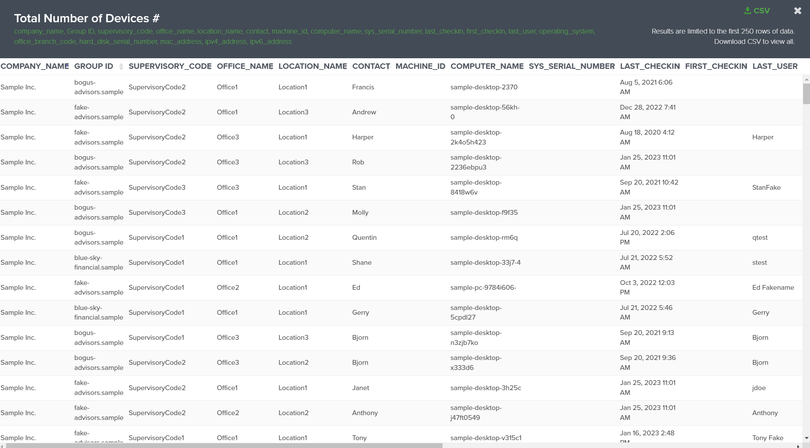
Sorting & Filtering Enterprise Data

Slide 8
Enterprise Data Maintenance
End-User entering and updating data
Integrated Data processing for
Supervisory reassignments
Enterprise user directory integration for data augmentation
Device Lifecycle Management
New device notification to the Security Officer
Evidence of compliance with Asset Inventory Report
Option for low impact enforcement
Device decommissioning with evidence

Slide 9
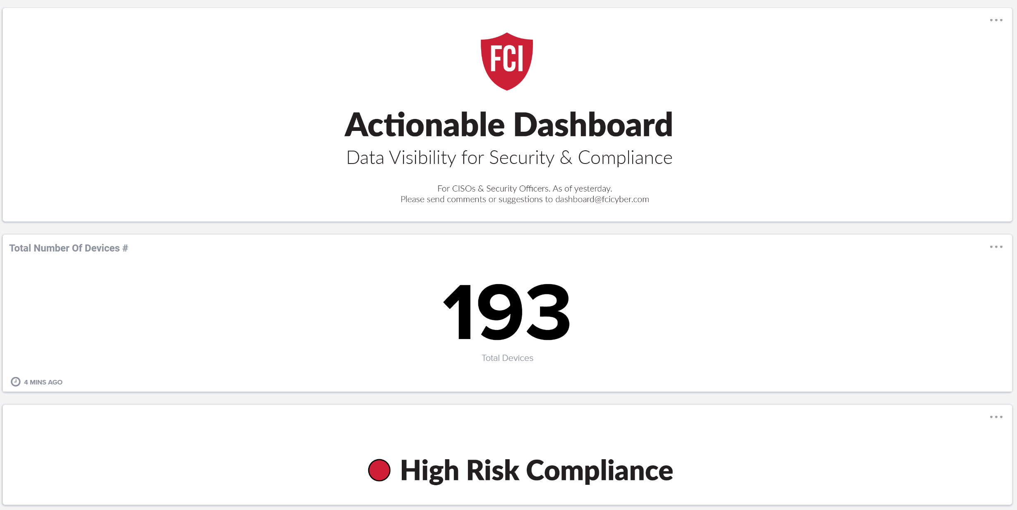
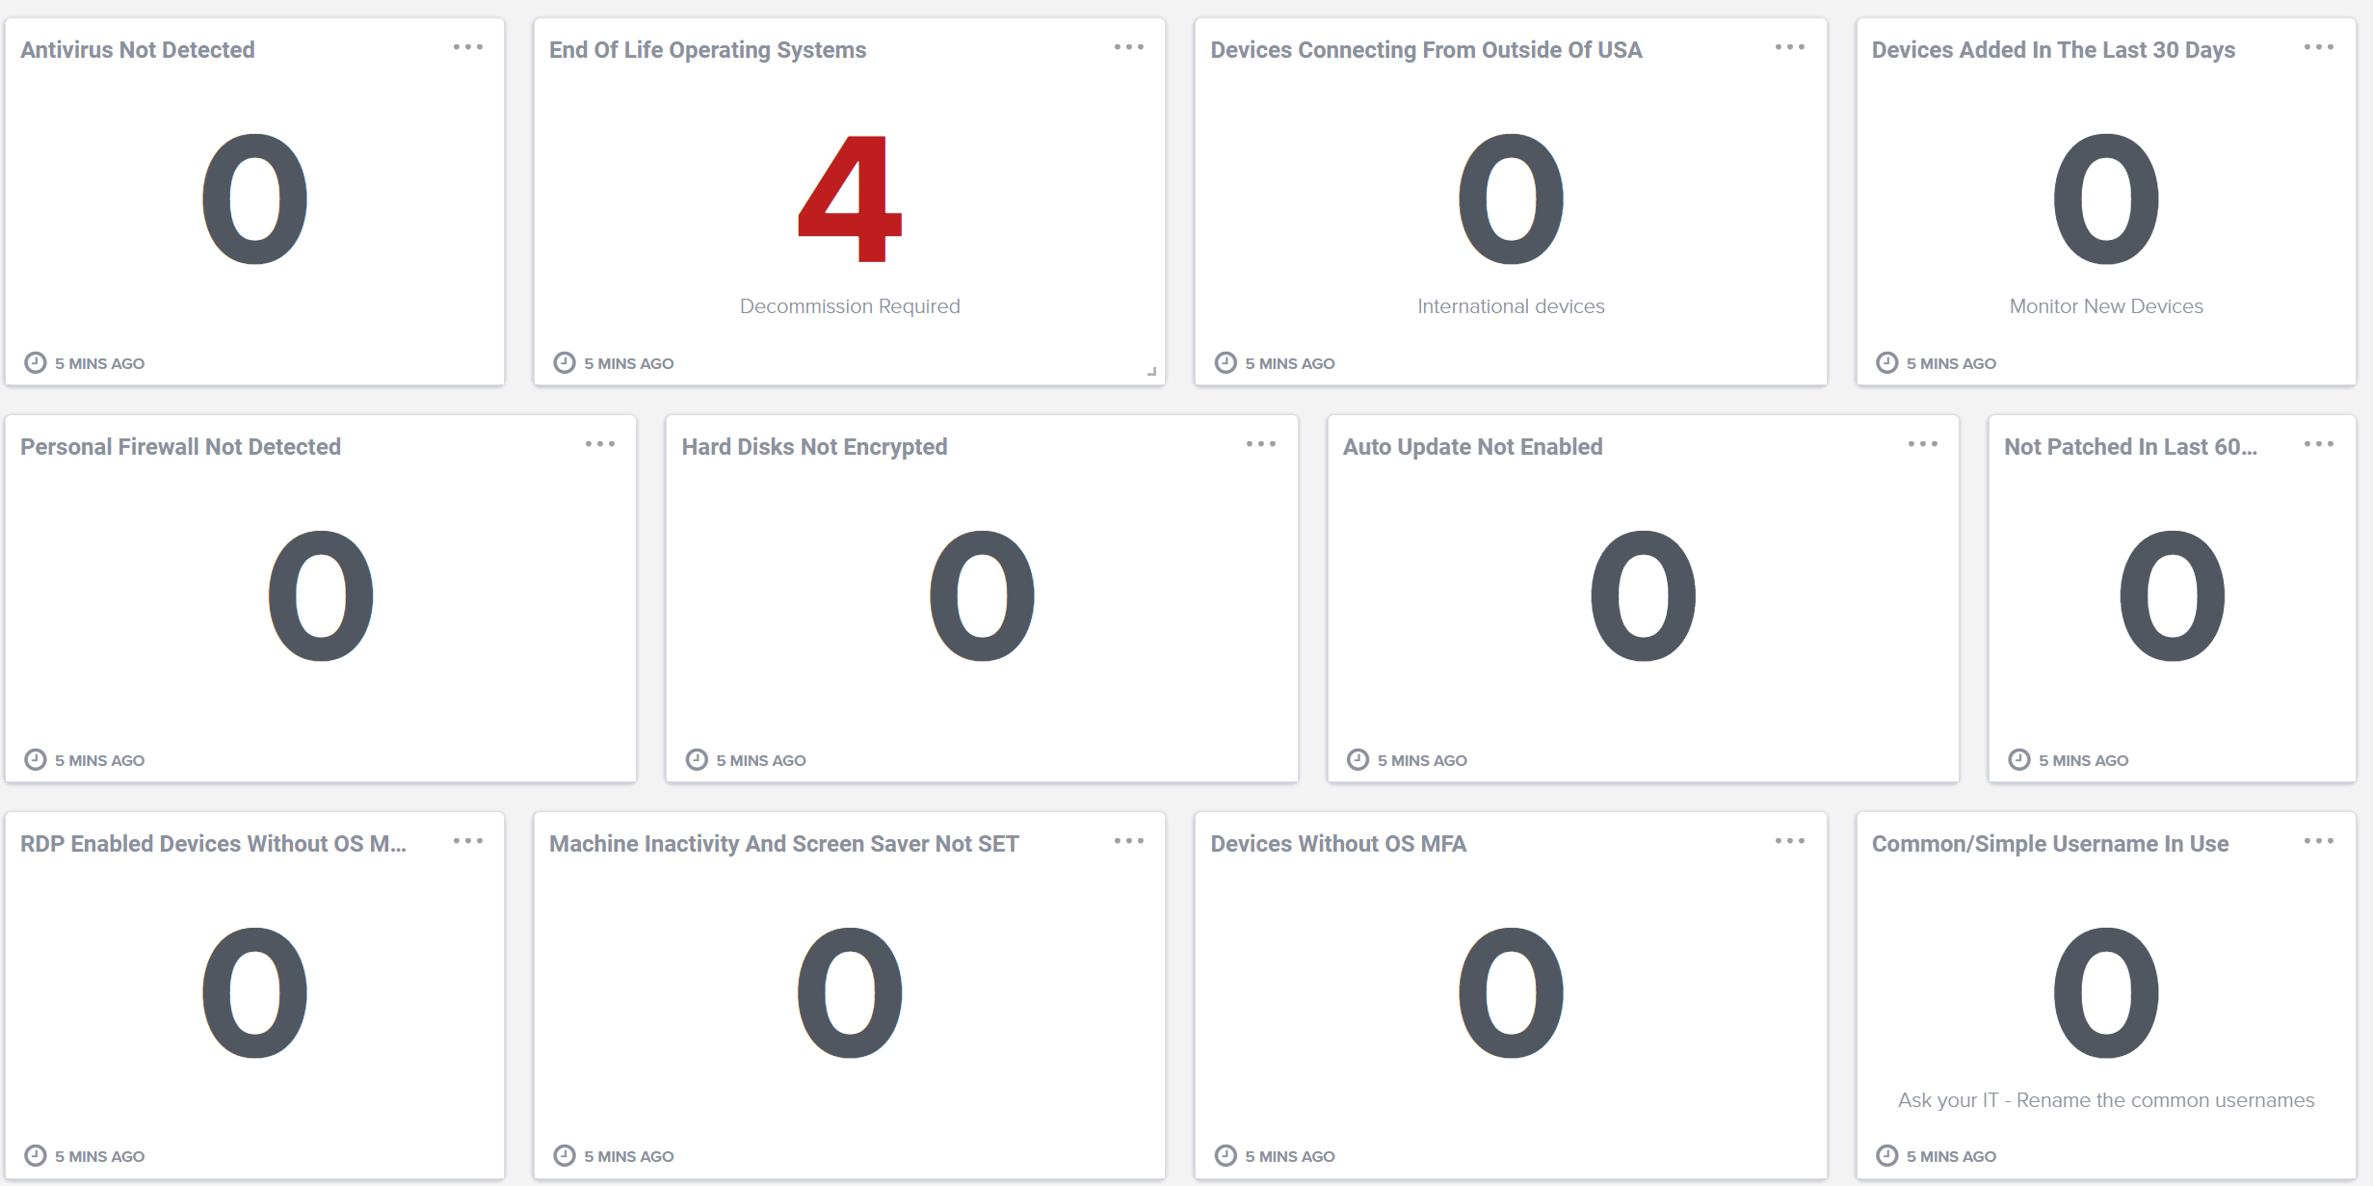
High-Risk Visibility

Slide 10
Benefits
Increases
Security: Enhances the security posture of financial firms by identifying and mitigating vulnerabilities.
Regulatory Compliance: Helps firms stay compliant with industry regulations, reducing the risk of fines and sanctions.
Operational Efficiency: Improves operational efficiency through automated audits and streamlined processes.
Reduces
Administrative Efforts: Simplifies the management of groups, reducing the administrative burden on IT staff.
Deployment Costs: Offers an easy system to deploy, significantly lowering the deployment costs compared to legacy systems.
Risks: Reduces costs associated with security breaches and non-compliance penalties.

Slide 11
60-Day Pilot Project
Installer
Weekly Asset Inventory Reports
New install notifications
Actionable Dashboard
Manual endpoint user data update
Option: Removal of legacy audit software

Slide 12
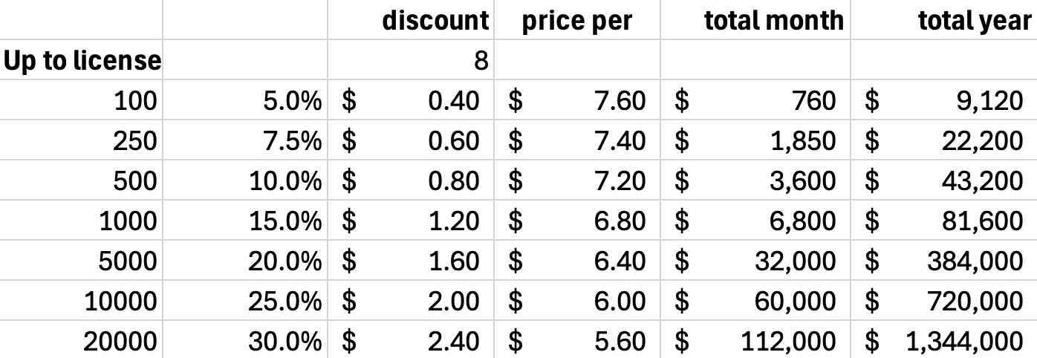
Price

Slide 13
Competition
Microsoft
Everything needs to be joined to the Enterprise Microsoft account
Challenges to integrate Offices’ M365
Smarch Entreda
Implementation
Maintenance
Legacy architecture, UI, and UX
No check for unknown devices
User is doing enforcement or tested for it (prompt)
Venn
No enforcement capability

Slide 14
Managed Cyber Tech Stack
Managed Cybersecurity Services
Centralized MFA (Multi-Factor Authentication)
Endpoint Security Enforcement
Endpoint Protection with MXDR (Managed Extended Detection & Response)
Data Exfiltration Protection & DLP (Data Leakage Protection)
Network Security
Cloud-Based Firewall with Always-On-VPN and SASE (Secure Access Service Edge
Centralized Logs / SIEM (Security Information & Event Management)
Centralized Configuration Change Logs
SOAR (Security Orchestration, Automation, & Response)
SOC (Security Operation Center) Cloud Hardening Services
CASB (Cloud Access Security Broker)
Security Assessment
Vulnerability Scans and Network Penetration Testing
Public Asset Assessment
Security Score

Slide 15
Visibility

Slide 16
High-Risk Vulnerability Fixes available with Visibility
Options that can be included with Visibility
OS Security Patch Enforcement (no management)
USB forced encryption
Others are available with Enforcement Services
See full list

Slide 17

Segmentation
Firm-Defined Segmentation
Location
Branch or Agency
Firm code
Title
Supervisory Code
Etc.
Visibility
Audit & Monitoring Tool
Segmentation Method
User-Managed
Data File Processing
System Integration
Technical Information Inventory Report
Cyber Posture Inventory Report
Actionable Dashboard

Slide 18
Actionable Dashboard
~10 Controls
End-od-Life OS
Remote Desktop Protocol(RDP) without MFA
Unique Usernames
Microsoft Managed Accounts
Etc.
Actionable Dashboard
Visibility Over Security & Compliance
~40 Safeguards
Antivirus
Full-Disk Encryption
Screen Saver, Inactivity Lockout
Complex Password
Computer Firewall
OS Security Patches
Etc.
Aggregation from multiple systems
IT and cyber settings and tools
Updated daily (not real-time)
Identify risks and act on them
Click on card to view computers
Download lists

Slide 19



Asset Inventory Reports
1. Technical Information Report
~ 20 Columns
Install date
Hardware
OS
Hard Disk
CPU
RAM
Serial numbers
Etc.
Asset Inventory Reports
Technical Information & Cyber Posture
2. Cyber Posture Report
~ 40 Columns
Antivirus
Full-Disk Encryption
Inactivity Timeout
Complex Password
Firewall
OS Patches
OS Multi-Factor Authentication
Etc.
Excel file with 1 Computer per Row for easy review
Sent over Public Networks (Time-stamped) For Future Evidence

Slide 20
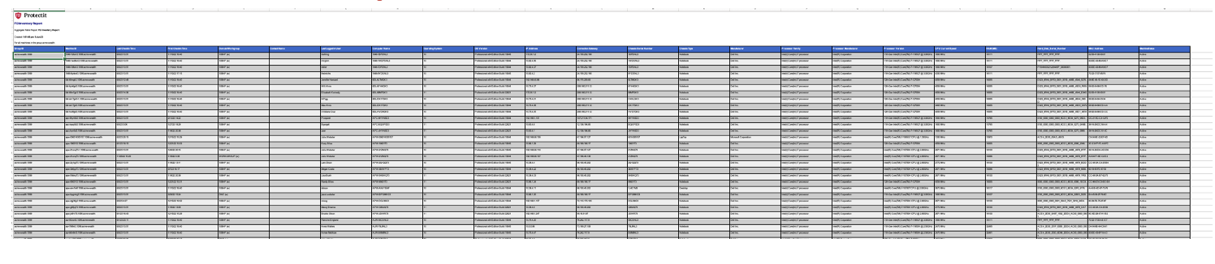
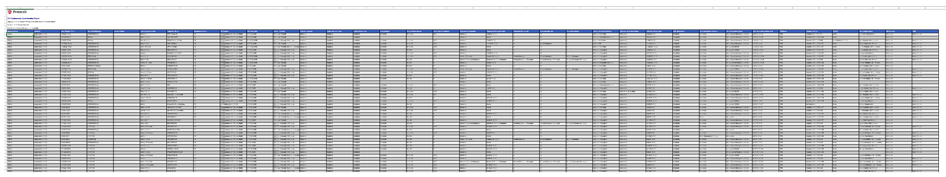
Computer Inventory Reports
Password Complexity
Password Expiration Date
Password Min Length
Password Max Age
Password History
Active Antivirus Products
Antivirus Definition Status
Antivirus Status Date
USB Encryption
Disk Encryption Product
Disk Encryption Status
Disk Encryption Status Date
TPM Status
Chrome Version
User Admin Status
RDP Access
IT RMM
Machine Status
Group ID
Last Check-in Time
Domain/Workgroup
Contact Name
Last Logged In User
Computer Name
Operating System
OS Version
OS Patch Date
OS MFA
Active Firewall
Firewall Logging
Login Success Log
Login Failure Log
Inactivity Timeout
Technical Information Report
Cyber Posture Report

Slide 21
Field Compliance
Approved Vendor Program
Do you have a program to review vendors, or the Field Offices are doing it?
If you have a program, can we participate?
Information Security Policy Document
Do you have a document that you send to the Field Offices?
If yes, can we get a copy to ensure we enforce the sections that apply to FCI services?
Annual Review of Field Office Compliance
Do you review the Cyber compliance of your Field Offices?
If you agree to promote it, we have a special offer (next slide)
Field Offices: FCI Clients
FCI Protectit
Client 1
Client 2
FCI Exchange Sync ?
Actionable Compliance Dashboard Demo
Per Firm
For All Firms
Segmentation per location, supervisory code, etc.

